Slide 1

Civil Rights
Annual Civil Rights Training for TEFAP and CSFP Agencies

Slide 2


Agenda
What is Discrimination?
Beneficiary Notice and Protections
Collection and Use of Client Data
Effective Public
Notification Systems
Requirements for Language Assistance
Reasonable Accommodation of Persons with Disabilities

Slide 3

Agenda
Complaint Procedures
Compliance Reviews
Resolution of Non-Compliance
Customer Service
Conflict Resolution

Slide 4

What is discrimination?
The act of distinguishing one person or group of persons from others, either intentionally, by neglect or by the effect of actions or lack of actions based on their protected classes.

Slide 5
Unintentional Discrimination
Unintentional - refers to policies, practices, rules or other systems that appear to be neutral, but result in a disproportionate impact on protected groups.

Slide 6
Intentional Discrimination
Intentional - to treat people differently based on their race or other protected characteristics.
Reprisal/Retaliation – Negative treatment due to prior civil rights activity by an individual or his/her family or known associates or for cooperating with an investigation.

Slide 7

Protected Bases/Classes
For civil rights in TEFAP and CSFP, the protected classes are:
Disability
National Origin
Age
Race
Color
Sex
People are also protected from retaliation.

Slide 8
Also Protected:
Religion
Political Beliefs
Marital Status
Familial Status
Sexual Orientation
Genetic Information
Income Derived from Public Assistance

Slide 9
Non-Discrimination Statement
All public information related to TEFAP and CSFP must contain the Non-Discrimination Statement
Long version vs short version
  “This institution is an equal opportunity provider.”

Slide 10


Non-Discrimination Statement
“In accordance with Federal civil rights law and U.S. Department of Agriculture (USDA) civil rights regulations and policies, the USDA, its Agencies, offices, and employees, and institutions participating in or administering USDA programs are prohibited from discriminating based on race, color, national origin, sex, disability, age, or reprisal or retaliation for prior civil rights activity in any program or activity conducted or funded by USDA.
Persons with disabilities who require alternative means of communication for program information (e.g. Braille, large print, audiotape, American Sign Language, etc.), should contact the Agency (State or local) where they applied for
benefits. Individuals who are deaf, hard of hearing or have speech disabilities may contact USDA through the Federal Relay Service at (800) 877-8339. Additionally, program information may be made available in languages other than English.
To file a program complaint of discrimination, complete the USDA Program Discrimination Complaint Form, (AD-3027) found online at: http://www.ascr.usda.gov/complaint_filing_cust.html, and at any USDA office, or write a letter addressed to USDA and provide in the letter all of the information requested in the form. To request a copy of the complaint form, call (866) 632-9992.
Submit your completed form or letter to USDA by:
mail: U.S. Department of Agriculture Office of the Assistant Secretary for Civil Rights
1400 Independence Avenue, SW Washington, D.C. 20250-9410;
fax: (202) 690-7442; or
email: program.intake@usda.gov.
This institution is an equal opportunity provider.”

Slide 11
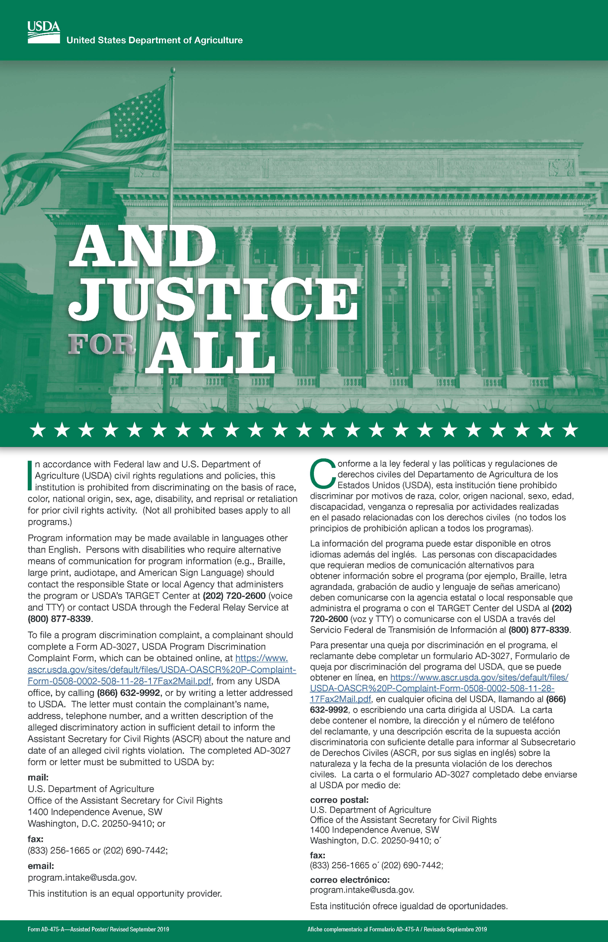

And Justice for All Poster
Must be posted where eligibility forms are completed and/or where food or meals are being distributed
Should be visible for all to see

Slide 12

Question time!
A young woman visits your pantry and is a new neighbor being entered into SIMC.
She reports she is 24, Caucasian, and there is no one else living in the home.
What 4 classes/bases is she protected under: Age, Race, Sex, and?

Slide 13

Beneficiary Notice Requirements
Partnerships with Faith-Based and Neighborhood Organizations:
Per 7 CFR Part 16.4(c)(1),
“All organizations that receive USDA Foods or administrative funds for CSFP and TEFAP must provide a written notice to all beneficiaries and prospective beneficiaries of certain protections in a manner and form prescribed by policy FD-155.”
Notes:
Purpose:
The purpose of this section is to briefly go over written notice and referral requirements for organizations that receive USDA Foods or administrative funding from CFSP or TEFAP pertaining to faith-based and neighborhood organizations.

Slide 14
Beneficiary Protections:
Written Notice (CSFP)
To notify future and prospective beneficiaries, organizations must supply individual written notice of beneficiary protections under 7 CFR Part 16 at the time of application for CSFP benefits.
  Providing CSFP applicants with a separate handout at the time of application.
  OR
  Incorporating the required notification as an attachment in their existing CSFP applications.
  OR
  Included in other materials that are provided to beneficiaries before the receipt of services.
Notes:
A physical copy MUST be given to CSFP beneficiaries via a handout, incorporation in notification, or provided in/with other materials given out before receipt of services. Subrecipients wishing to incorporate the written notice into the eligibility form must submit it to their CSFP coordinator for review.

Slide 15
Beneficiary Protections:
Written Notice (TEFAP)
To notify current and future or prospective beneficiaries, organizations providing TEFAP services must supply written notice of beneficiary protections under 7 CFR Part 16 by choosing two or more of these three methods:
  Post a written notice at service locations. The posted written notice must be visible to all TEFAP beneficiaries and prospective beneficiaries upon entrance into the distribution site.
  OR
  Provide flyers or handouts at each distribution
  OR
  Add the written notification to their TEFAP intake form.
Notes:
To notify current and future or prospective beneficiaries, organizations providing TEFAP services must supply written notice of beneficiary protections under 7 CFR Part 16 by choosing one or more of these three methods:
A written notice must be posted at service locations, Flyers or handouts can be provided at each distribution or a written notification can be provided on the TEFAP intake form. Subrecipients wishing to incorporate the written notice into the eligibility form must submit it to their TEFAP coordinator for review.

Slide 16

Beneficiary Protections: Referral Requirements
For both CSFP and TEFAP, the written notice described MUST also inform all parties about how to obtain information from either FNS or the State agency about other federally funded service providers in their area.
Provision requirements went into effect on July 2, 2024.
Monitoring for compliance of these requirements will be conducted as part of your agency’s scheduled administrative review.
Notes:
Both programs Must share how to get information from FNS or the state agency for other federally funded service in the area.
State agencies MUST determine what method of referral they will require and inform all applicable parties.
All organizations participating in CSFP and TEFAP were required to begin providing beneficiaries with the written notice required by these amended regulations no later than July 2, 2024 .
Our review team will be monitoring compliance with these requirement when they conduct your agency’s scheduled review.

Slide 17
Data Collection
Not required in TEFAP
Race and ethnicity required for CSFP
  Self-declared on forms
  If not declared, they must be advised that the information will be collected based on observation
  Secure and confidential
  Maintain records
  Applicants shall be assured that the information has no effect on eligibility criteria

Slide 18
Data Collection
IDs or driver's licenses are no longer required.
          Home address information is self-declared

Slide 19
Public Notification
Public notification, or “outreach,” is required
Informs potential clients of program availability, rights and complaint procedures
Try to reach underserved groups who may qualify using a variety of formats and languages

Slide 20

Reaching Prospective Clients
Public Notification/Outreach Methods
Press releases – newspaper, TV station, online
Advertisements – newspaper, social media, TV
Signs – outside your facility, post serving times
Flyers – clinics, public assistance offices, schools, libraries, etc.

Slide 21
True or False?
Your flyers worked!
A family in need heard about your pantry and fills out a TEFAP application to receive USDA foods. Their address is listed as being in Palm Beach County and your pantry is in Lee County.
They are income eligible to receive TEFAP.
True or False: You can distribute USDA foods to them?

Slide 22
Limited English Proficiency
Persons with LEP are those who have the limited ability to read, speak, write or understand English
Agencies must take reasonable steps to ensure meaningful access to services
Consider the possible LEP clients in your area for both outreach and food distribution
Interpreters

Slide 23

Limited English Proficiency
Factors to consider:
Number or proportion of LEP persons served or encountered in the eligible population
Frequency with which LEP individuals come in contact with the program
Nature and importance of the program, activity, or service provided by the program
Resources available to the recipient
Costs

Slide 24

Persons with Disabilities
Disabled person
A person who has a physical or mental impairment which substantially limits one or more major life activities, has a record of such an impairment, or is regarded as having such an impairment.
Major life activity means functions such as caring for one’s self, performing manual tasks, walking, seeing, hearing, speaking, breathing, learning and working.

Slide 25
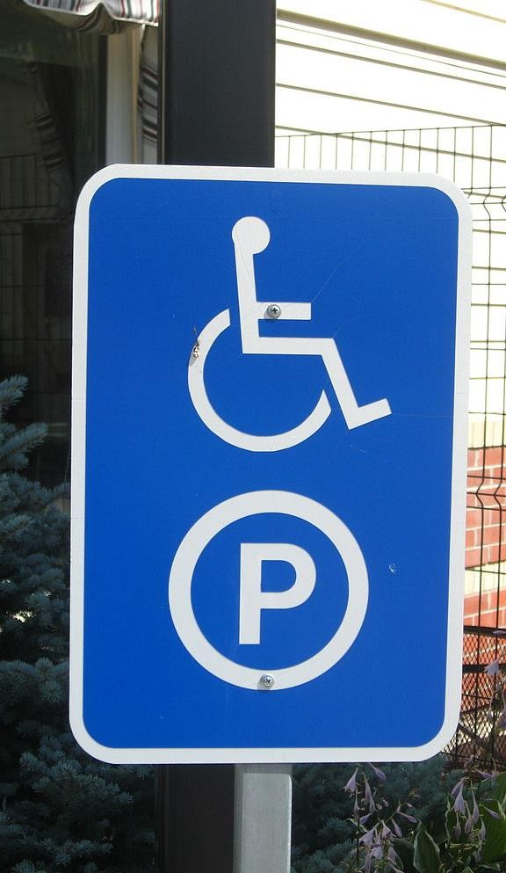
Persons with Disabilities
Reasonable accommodations that do not cause undue hardship must be provided.
A handicap accessible facility considers:
  Parking lot
  Entrances
  Exits
  Hallways
  Elevators
  Restrooms
  Braille signage

Slide 26
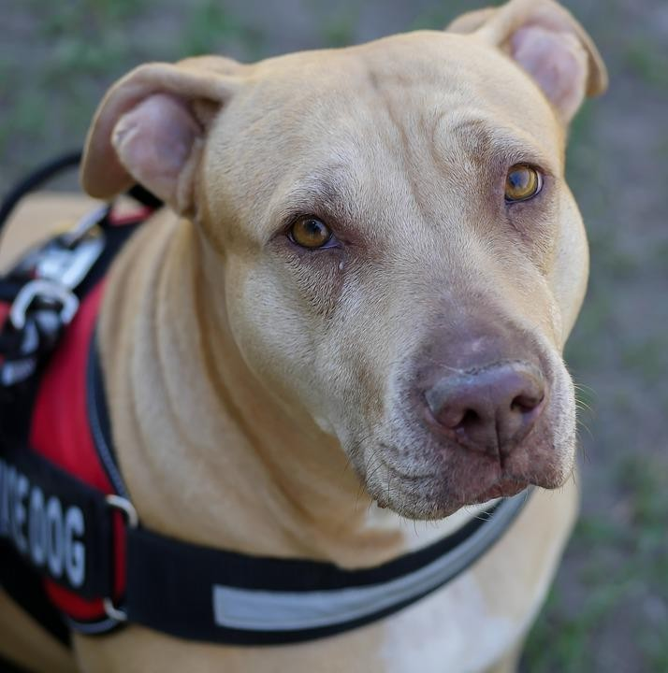
Persons with Disabilities
Always have assistance available for people with disabilities
Provide alternative arrangements for service
Sign language interpreters
Service animals

Slide 27
Civil Rights Complaints
Verbal, written or anonymous
Can be made to any person at any level
Civil rights complaint is based on the 6 protected classes
Other complaints are program complaints
Have specific process and procedures for your agency

Slide 28
Program Complaints
Program complaints are still very important
Have a different complaint process for handling these
Examples of program complaints
  Not one of the six protected classes
  Food safety/quality issues
  Customer service, such as standing in a long line to receive food

Slide 29
Processing a Civil Rights Complaint
Step 1. Supply clients with USDA complaint form or take down all information
Step 2. Complaint is filed direct by neighbor or sent to FDACS by agency
Step 3. FDACS notifies USDA Step 4. Investigation

Slide 30
Handling a Complaint
Handling a Civil Rights Complaint requires careful attention to detail.
Listen to the person making the complaint
Practice good customer service
Write it down using an established form
Immediately move complaint up to person in charge

Slide 31
Compliance Reviews
Compliance reviews examine activities to determine Civil Rights compliance
Three types
  Pre-award compliance review
  Routine compliance review
  Special compliance review

Slide 32
Pre-Award Compliance Review
Occurs before you receive any food (or financial assistance, if applicable)
Happens at all levels

Slide 33
Routine Compliance Review
Scheduled
Part of regular program review
Looks for non-discrimination statement on printed materials, And Justice for All poster, reasonable accommodations for people with disabilities, etc.

Slide 34
Special Compliance Reviews
Follow up on previous findings
Investigate reports of noncompliance
Pattern for complaints of discrimination
May be scheduled or unscheduled

Slide 35
Resolution of Noncompliance
A factual finding that any civil rights requirement, as provided by law, regulation, policy, instruction, or guidelines, is not being adhered to by a state agency, local agency or sub-recipient.
You will receive written notice indicating:
Areas of noncompliance
Action required to correct the situation

Slide 36
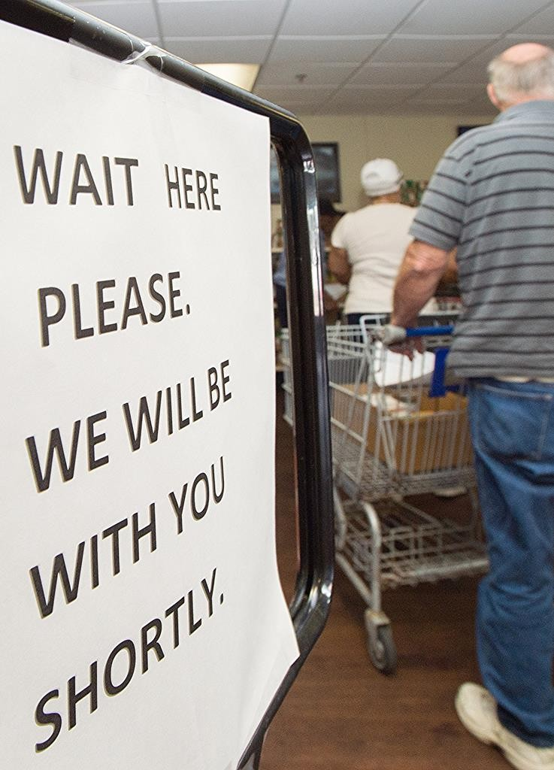
Customer Service
Equal treatment and service for all clients
Make people feel welcomed
Communicate
No special favors

Slide 37
Conflict Resolution
Post your agency’s policy for unacceptable behavior and conflicts
When conflict arises:
  Stay calm
  Don’t interrupt
  Listen, be understanding and do not be judgmental
  Identify the problem and possible solutions
  Follow up with the client
  Get help if you feel threatened or uncomfortable

Slide 38

Nicole Vinacco
Programs Support Specialist
Harry Chapin Food Bank of Southwest Florida
239-334-7007, ext. 153 (office)
Nvinacco@hcfb.org

